Slide 1
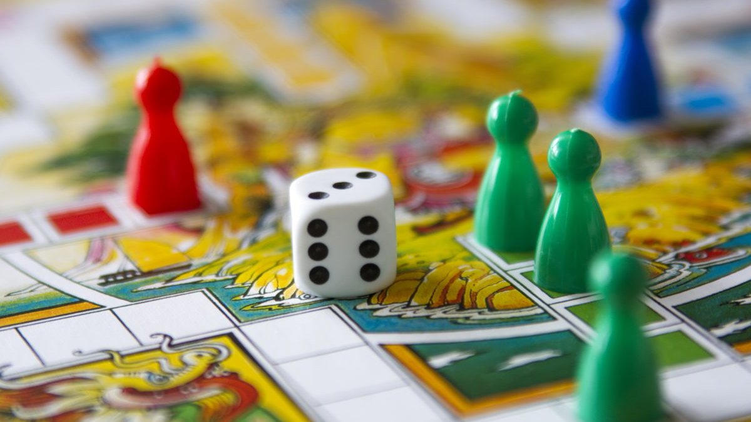
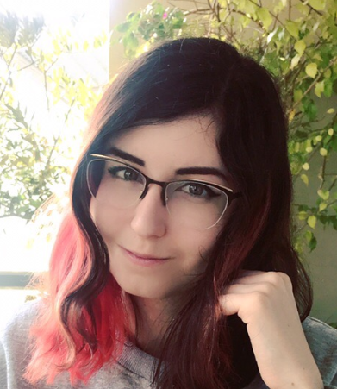
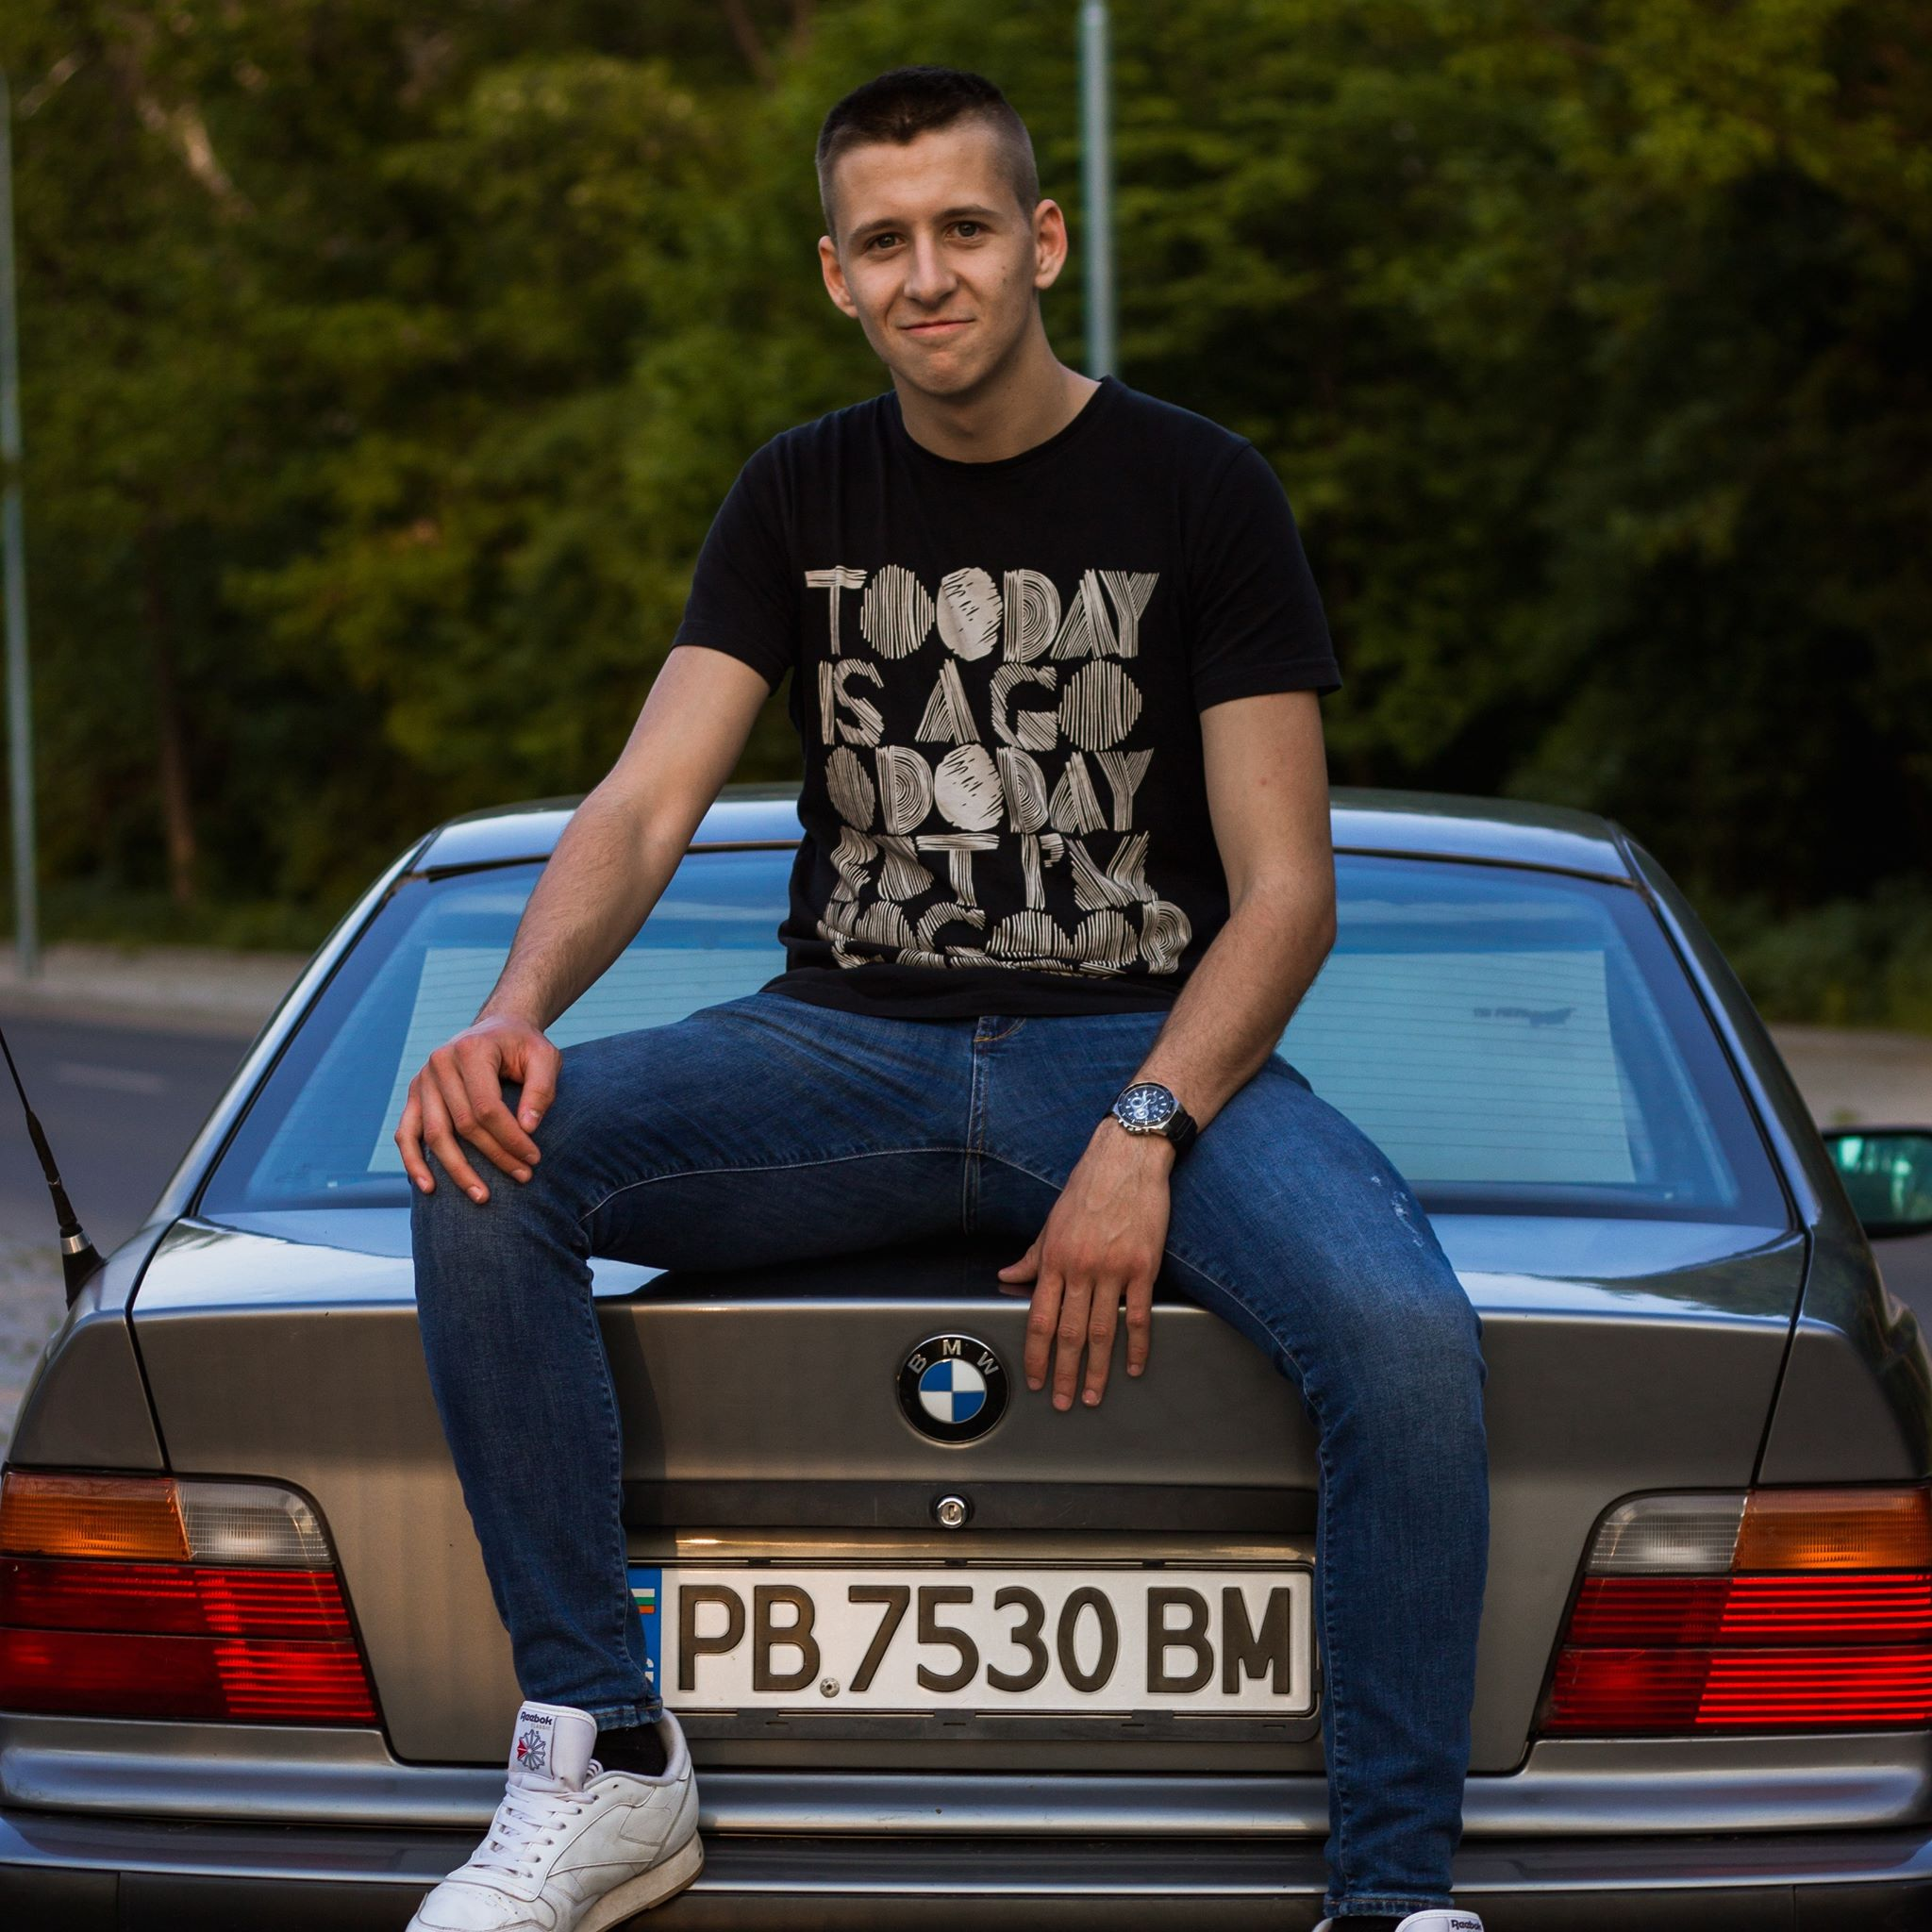
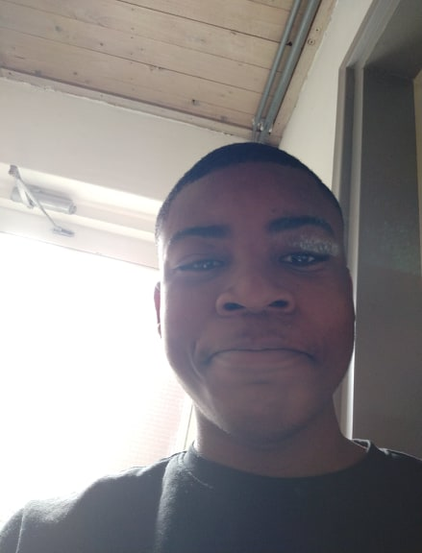
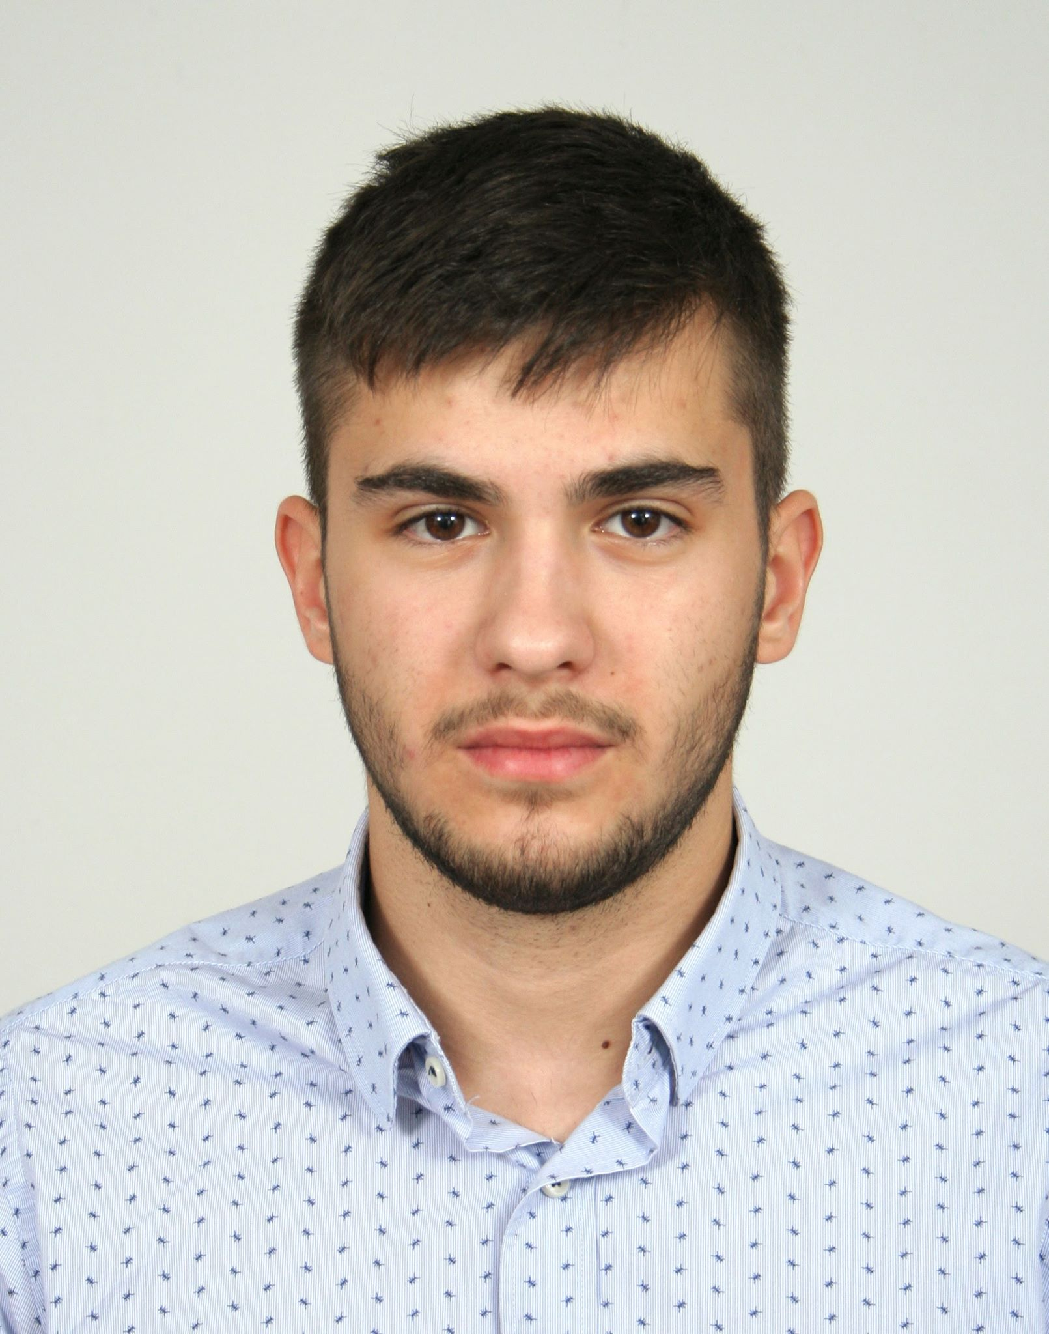
Team introduction
Maria Khovanskaya
e-b21
Dimitr Ivanov
e-s26
“Mad projects”
David Hooi
e-t21
Martin Grigorov
e-s22

Slide 2
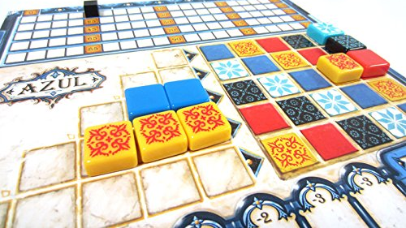
Introduction about the project
Steps:
Determine processes
Efficient automatization
Development
Testing
Website and applications for event management:
Tickets management
Purchases management
Rent management
Transactions management
Key values:
Usability
Scalability
Performance
Stability
Notes:
Usability – everything is comfortable and easy for user
Scalability – it’s easy to add new features or resize the project to bigger events or more events
Performance – everything runs fast and smooth

Slide 3
Website
Event pack
Website
Application
Used by visitors to:
Create an account (login/logout)
Purchase ticket (+ buy merch)
Top-up balance
Reserve a camp spot
Leave and read reviews
Contact event/developers
Used by employees to:
HERE PLZ ADD WHAT IT IS USED FOR BRIEFLY

Slide 4
Website
Why our website
Intuitively understandable interface

Slide 5
Why our application

Slide 6
Personal impression: David

Slide 7
Personal impression: Martin

Slide 8
Personal impression: Dimitar

Slide 9
Personal impression: Maria

